Slide 1
Breast Cancer Detection
By : Zeina Ahmed
ID : 320210137
Sec: 2

Slide 2
Introduction
Breast cancer remains one of the leading causes of mortality among women worldwide.
Early and accurate detection is crucial for effective treatment and improved survival rates.

Slide 3
Problem Definition
Breast cancer diagnosis challenges include variability in tumor appearance and the presence of noise and artifacts in ultrasound imaging.
These factors can hinder the effective interpretation and classification of benign and malignant tissues. Therefore, enhancing the quality of ultrasound images and developing robust algorithms for accurate classification is essential.

Slide 4
Objectives
Noise Reduction: Minimizing noise to prevent obscuration of crucial tissue details.
Contrast Enhancement: Enhancing image contrast to better delineate features indicative of malignancy.
Feature Enhancement: Utilizing edge detection filters to differentiating between benign and malignant lesions.
Automated Classification: Developing a CNN model to classify the processed images into benign or malignant categories, aiding in rapid and accurate diagnosis.

Slide 5
Methodology
The methodology involves processing and analyzing a dataset of ultrasound breast images :
Median Filtering: Reduces salt-and-pepper noise prevalent in ultrasound images.
Histogram Equalization: Enhances image contrast by adjusting the image's histogram, making the structures more distinct.

Slide 6
Methodology
Contrast Stretching: Normalizes the brightness and improves contrast across images to ensure that all images are evaluated under similar conditions.
Sobel Filtering: Detects edges in both horizontal and vertical directions, highlighting potential tumor boundaries.
Laplacian Filtering: Enhances edges and fine details, critical for the detailed analysis of tissue structures.

Slide 7
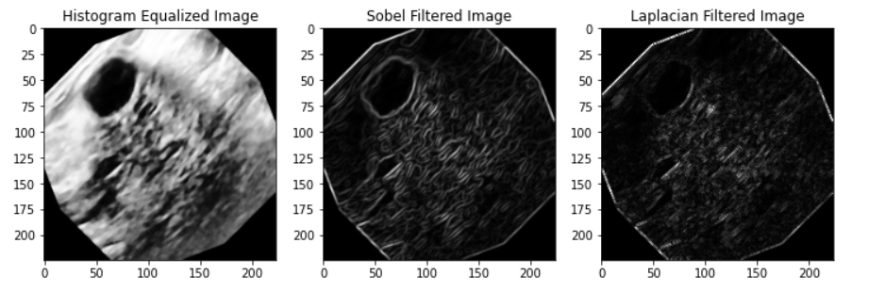
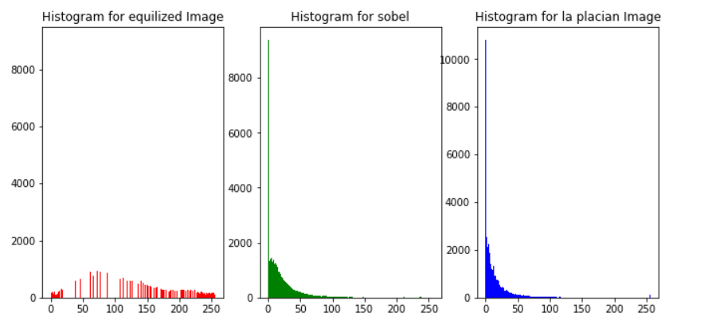
Visualization

Slide 8
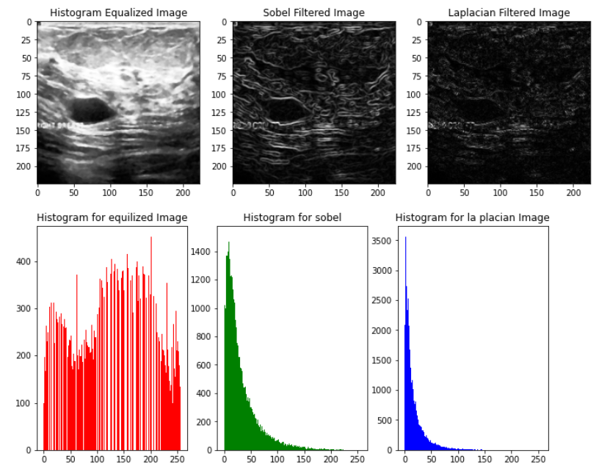

Slide 9
Methodology
These preprocessed images are then fed
into a CNN, designed and trained to classify
the images into benign or malignant
categories based on learned features from
the training data.

Slide 10
Results
Noise Reduction: The median filter effectively removed extraneous noise, resulting in clearer image details.
Contrast Enhancement: Adjustments made through histogram equalization and contrast stretching made subtle differences in tissue density more apparent, which are crucial for early detection.

Slide 11
Results
Edge and Feature Enhancement: Sobel and Laplacian filters successfully highlighted critical boundaries and textures associated with malignant growths.
Classification Accuracy: The CNN model achieved a high level of accuracy, demonstrating the effectiveness of combining advanced image processing with deep learning for breast cancer diagnosis.

Slide 12
Results
The enhancements in image processing and classification techniques described in could potentially be integrated into clinical workflows, providing support for radiologists in making more accurate and timely breast cancer diagnoses.
This approach underscores the benefits of combining image processing with machine learning to improve diagnostic outcomes in medical imaging.

Slide 13
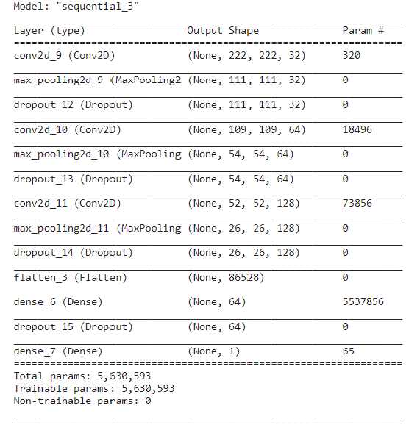
Model Architecture

Slide 14
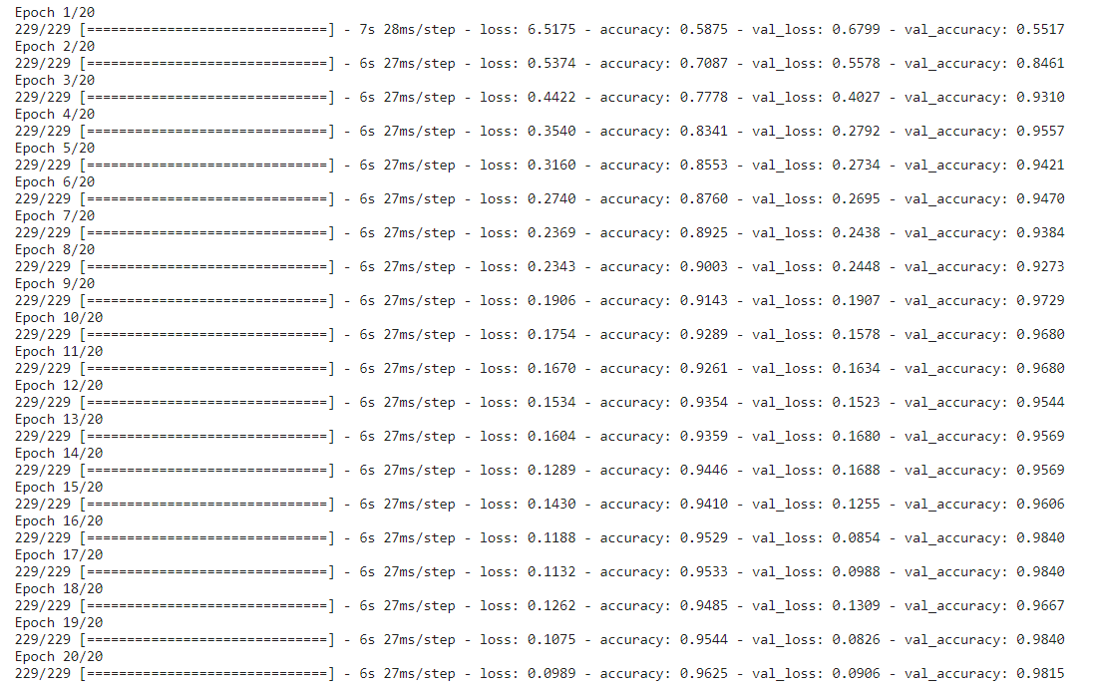

Training and Validation

Slide 15
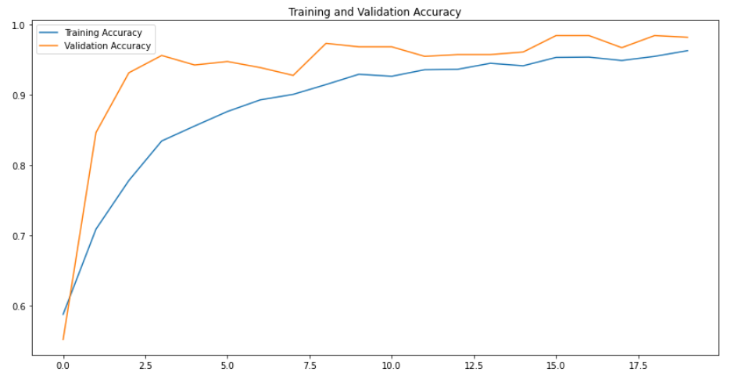
Accuracy

Slide 16
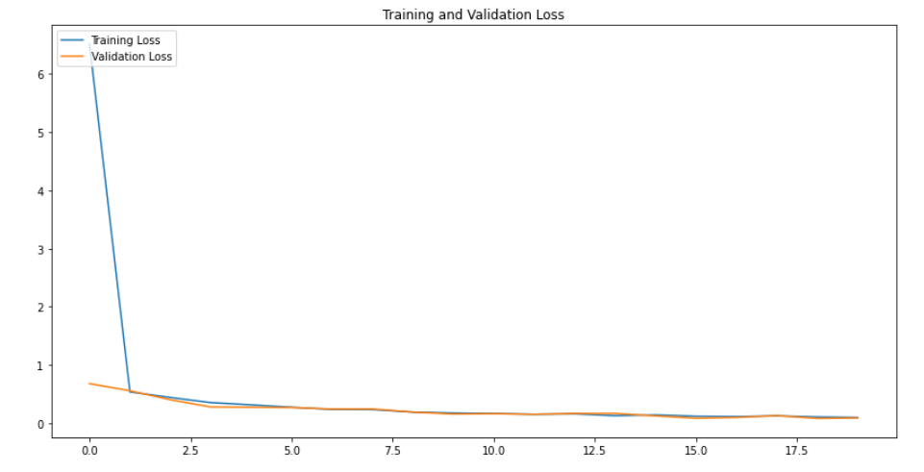
Loss

Slide 17


